Slide 1

Andalus Prime

Slide 2
Topics
    Introduction
    Sieve of Eratosthenes
    Andalus Prime Algorithm
    Complexity Analysis
    Mersenne Prime
Andalus Prime

Slide 3
Topics
    Introduction
    Sieve of Eratosthenes
    Andalus Prime Algorithm
    Complexity Analysis
    Mersenne Prime
Andalus Prime

Slide 4
Introduction
An integer greater than one is called a prime number if its only positive divisors (factors) are one and itself.
For example, the prime divisors of 10 are 2 and 5; and the first six primes are 2, 3, 5, 7, 11 and 13 .

Slide 5
Introduction
The Fundamental Theorem of Arithmetic shows that the primes are the building blocks of the positive integers: every positive integer is a product of prime numbers in one and only one way, except for the order of the factors.
The number of primes less than or equal to n approaches n/log n) (as n gets very large); so a rough estimate for the n^{th} prime is n log n.
To find individual small primes trial division works well. To test n for primality just divide by all of the primes less than the square root of n. For example, to show is 211 is prime, we just divide by 2, 3, 5, 7, 11, and 13.

Slide 6
Topics
    Introduction
    Sieve of Eratosthenes
    Andalus Prime Algorithm
    Complexity Analysis
    Mersenne Prime
Andalus Prime

Slide 7
Sieve of Eratosthenes
Make a list of all the integers less than or equal to n (greater than one) and strike out the multiples of all primes less than or equal to the square root of n, then the numbers that are left are the primes.
For example, to find all the odd primes less than or equal to 100 we first list the odd numbers from 3 to 100 (why even list the evens?) The first number is 3 so it is the first odd prime--cross out all of its multiples. Now the first number left is 5, the second odd prime--cross out all of its multiples. Repeat with 7 and then since the first number left, 11, is larger than the square root of 100, all of the numbers left are primes.
Andalus Prime

Slide 8
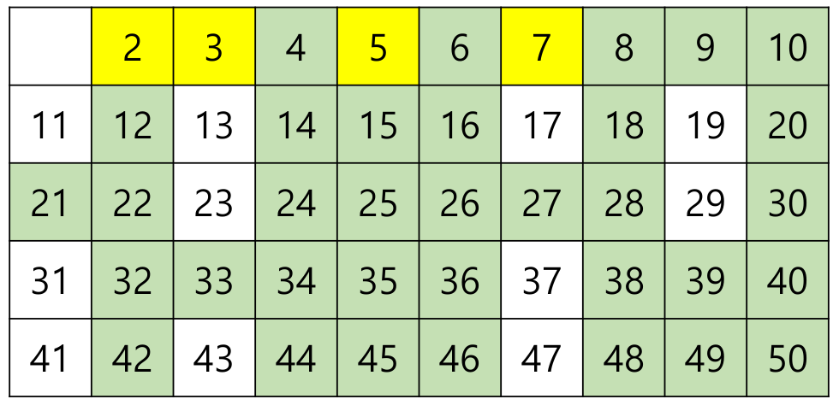
Sieve of Eratosthenes
Andalus Prime

Slide 9
Topics
    Introduction
    Sieve of Eratosthenes
    Andalus Prime Algorithm
    Complexity Analysis
    Mersenne Prime
Andalus Prime

Slide 10
Andalus Prime
Take any integer n greater than 3, and divide it by 6. That is, write n = 6q + r
where q is a non-negative integer and the remainder r is one of 0, 1, 2, 3, 4, or 5.
If the remainder is 0, 2 or 4, then the number n is divisible by 2, and can not be prime. If the remainder is 3, then the number n is divisible by 3, and can not be prime.
So if n is prime, then the remainder r is either
  1 (and n = 6q + 1 is one more than a multiple of six), or
  5 (and n = 6q + 5 = 6(q+1) - 1 is one less than a multiple of six).
Remember that being one more or less than a multiple of six does not make a number prime.
Andalus Prime

Slide 11
Andalus Prime
5 | 7 | 11 | 13 | 17 | 19 | 23 | 25 | 29 | 31
35 | 37 | 41 | 43 | 47 | 49 | 53 | 55 | 59 | 61
65 | 67 | 71 | 73 | 77 | 79 | 83 | 85 | 89 | 91
95 | 97 | 101 | 103 | 107 | 109 | 113 | 115 | 119 | 121
125 | 127 | 131 | 133 | 137 | 139 | 143 | 145 | 149 | 151
155 | 157 | 161 | 163 | 167 | 169 | 173 | 175 | 179 | 181
Andalus Prime

Slide 12
Andalus Prime
all unmarked cells are guaranteed to be prime.
5 | 7 | 11 | 13 | 17 | 19 | 23 | 25 | 29 | 31
35 | 37 | 41 | 43 | 47 | 49 | 53 | 55 | 59 | 61
65 | 67 | 71 | 73 | 77 | 79 | 83 | 85 | 89 | 91
95 | 97 | 101 | 103 | 107 | 109 | 113 | 115 | 119 | 121
125 | 127 | 131 | 133 | 137 | 139 | 143 | 145 | 149 | 151
155 | 157 | 161 | 163 | 167 | 169 | 173 | 175 | 179 | 181
Andalus Prime

Slide 13
Andalus Prime
To find the number x from index i
  x = 3i +1 if i is even
  x = 3i +2 if i is odd
  If we multiply any two numbers that is expressed in the form of 6n ± 1 then the result is also expressed in the form of 6n ± 1.
Andalus Prime

Slide 14
Andalus Prime
For any prime p, all multiples of p larger than p are composite.
Mark all multiples of 5 greater than 5 that is expressed in 6n ± 1.
5 | 7 | 11 | 13 | 17 | 19 | 23 | 25 | 29 | 31
35 | 37 | 41 | 43 | 47 | 49 | 53 | 55 | 59 | 61
65 | 67 | 71 | 73 | 77 | 79 | 83 | 85 | 89 | 91
95 | 97 | 101 | 103 | 107 | 109 | 113 | 115 | 119 | 121
125 | 127 | 131 | 133 | 137 | 139 | 143 | 145 | 149 | 151
155 | 157 | 161 | 163 | 167 | 169 | 173 | 175 | 179 | 181
Andalus Prime

Slide 15
Andalus Prime
Mark all multiples of 7 greater than 7 that is expressed in 6n ± 1.
5 | 7 | 11 | 13 | 17 | 19 | 23 | 25 | 29 | 31
35 | 37 | 41 | 43 | 47 | 49 | 53 | 55 | 59 | 61
65 | 67 | 71 | 73 | 77 | 79 | 83 | 85 | 89 | 91
95 | 97 | 101 | 103 | 107 | 109 | 113 | 115 | 119 | 121
125 | 127 | 131 | 133 | 137 | 139 | 143 | 145 | 149 | 151
155 | 157 | 161 | 163 | 167 | 169 | 173 | 175 | 179 | 181
Andalus Prime

Slide 16
Andalus Prime
Mark all multiples of 11 greater than 11 that is expressed in 6n ± 1.
5 | 7 | 11 | 13 | 17 | 19 | 23 | 25 | 29 | 31
35 | 37 | 41 | 43 | 47 | 49 | 53 | 55 | 59 | 61
65 | 67 | 71 | 73 | 77 | 79 | 83 | 85 | 89 | 91
95 | 97 | 101 | 103 | 107 | 109 | 113 | 115 | 119 | 121
125 | 127 | 131 | 133 | 137 | 139 | 143 | 145 | 149 | 151
155 | 157 | 161 | 163 | 167 | 169 | 173 | 175 | 179 | 181
Andalus Prime

Slide 17
Andalus Prime
Mark all multiples of 13 greater than 13 that is expressed in 6n ± 1.
5 | 7 | 11 | 13 | 17 | 19 | 23 | 25 | 29 | 31
35 | 37 | 41 | 43 | 47 | 49 | 53 | 55 | 59 | 61
65 | 67 | 71 | 73 | 77 | 79 | 83 | 85 | 89 | 91
95 | 97 | 101 | 103 | 107 | 109 | 113 | 115 | 119 | 121
125 | 127 | 131 | 133 | 137 | 139 | 143 | 145 | 149 | 151
155 | 157 | 161 | 163 | 167 | 169 | 173 | 175 | 179 | 181
Andalus Prime

Slide 18
Andalus Prime
Now, all multiples of 5, 7, 11, 13 are marked. Since ≈13.45, all unmarked cells are guaranteed to be prime.
5 | 7 | 11 | 13 | 17 | 19 | 23 | 25 | 29 | 31
35 | 37 | 41 | 43 | 47 | 49 | 53 | 55 | 59 | 61
65 | 67 | 71 | 73 | 77 | 79 | 83 | 85 | 89 | 91
95 | 97 | 101 | 103 | 107 | 109 | 113 | 115 | 119 | 121
125 | 127 | 131 | 133 | 137 | 139 | 143 | 145 | 149 | 151
155 | 157 | 161 | 163 | 167 | 169 | 173 | 175 | 179 | 181
Andalus Prime

Slide 19
Andalus Prime
• Therefore, we can consider all unmarked numbers as primes.
5 | 7 | 11 | 13 | 17 | 19 | 23 | 25 | 29 | 31
35 | 37 | 41 | 43 | 47 | 49 | 53 | 55 | 59 | 61
65 | 67 | 71 | 73 | 77 | 79 | 83 | 85 | 89 | 91
95 | 97 | 101 | 103 | 107 | 109 | 113 | 115 | 119 | 121
125 | 127 | 131 | 133 | 137 | 139 | 143 | 145 | 149 | 151
155 | 157 | 161 | 163 | 167 | 169 | 173 | 175 | 179 | 181
Andalus Prime

Slide 20
Andalus Prime
Number | Index of their multiple in the table | Formula for the pattern n = 0,1,2,... | The difference between the starts
5 | 8 18 28 38 48 58 68 78 88 98 11 21 31 41 51 61 71 81 91 | 8 + 10n = 8 + 2 * 5n 11 + 10n = 11 + 2 * 5n | 11 – 8 = 3
7 | 11 25 39 53 67 81 95 109 123 16 30 44 58 72 86 100 114 128 | 11 + 14n = 11 + 2 * 7n 16 + 14n = 16 + 2 * 7n | 16 – 11 = 5
11 | 18 40 62 84 106 128 150 172 25 47 69 91 113 135 157 179 | 18 + 22n = 18 + 2 * 11n 25 + 22n = 25 + 2 * 11n | 25 – 18 = 7
13 | 21 47 73 99 125 151 177 203 30 56 82 108 134 160 186 212 | 21 + 26n = 21 + 2 * 13n 30 + 26n = 30 + 2 * 13n | 30 – 21 = 9
17 | 28 62 96 130 164 198 232 266 39 73 107 141 175 209 243 277 | 28 + 34n = 28 + 2 * 17n 39 + 34n = 39 + 2 * 17n | 39 – 28 = 11
Andalus Prime

Slide 21
Andalus Prime
Number | Index of their multiple in the table | Formula for the pattern n = 0,1,2,... | The difference between the starts
19 | 31 69 107 145 183 221 259 297 44 82 120 158 196 234 272 310 | 31 + 38n = 31 + 2 * 19n 44 + 38n = 44 + 2 * 19n | 44 – 31 = 13
23 | 38 84 130 176 222 268 314 360 53 99 145 191 237 283 329 375 | 38 + 46n = 38 + 2 * 23n 53 + 46n = 53 + 2 * 23n | 53 – 38 = 15
25 | 41 91 141 191 241 291 341 391 58 108 158 208 258 308 358 408 | 41 + 50n = 41 + 2 * 25n 58 + 50n = 58 + 2 * 25n | 28 – 41 = 17
29 | 48 106 164 222 280 338 396 454 67 125 183 241 299 357 415 473 | 48 + 58n = 48 + 2 * 29n 67 + 58n = 67 + 2 * 29n | 67 – 48 = 19
31 | 51 113 175 237 299 361 423 485 72 134 196 258 320 382 444 506 | 51 + 62n = 51 + 2 * 31n 72 + 62n = 72 + 2 * 31n | 72 – 51 = 21
Andalus Prime

Slide 22
Andalus Prime
We can assign start=1, it is a₁ of the arithmetic sequence.
At each iteration it increase by 7 if start is odd or increase by 3 if start is even.
There are two different patterns for each number. Their only difference is the starting number. Let say the difference between the two a₁ is step. At the first time step = 1.
For each iteration the step is increased by 2.
The two arithmetic sequences are
  start + 2 * number * n n = 0, 1, 2, 3, …
  start + step + 2 * number * n n = 0, 1, 2, 3, …
Andalus Prime

Slide 23
Andalus Prime Algorithm
  while (p<=s){
  i++;
  start += start%2? 7:3;
  step += 2;
  if(prime[i])continue;
  p = i%2? 3*i+2: 3*i+1;
  for(int k=start; k<last; k += 2*p)
  prime[k]=true;
  for(int k=start + step; k<last; k += 2*p)
  prime[k]=true;
  }
}
const int N = 1000000009;
bool prime[N / 3];
void andalus(){
prime[0]=true;
int last = N/3;
int p=5, i=0, step=1, start=1;
int s = sqrt(N);

Slide 24
Andalus Prime
void display(){
cout<<2 <<” “<<3 <<” “;
int last = N/3;
for(int i = 0; i<last; i++)
if (!prime[[i])
cout<<(i%2? 3*i+2: 3*i+1)<<” “;
}
Andalus Prime

Slide 25
Topics
    Introduction
    Sieve of Eratosthenes
    Andalus Prime Algorithm
    Complexity Analysis
    Mersenne Prime
Andalus Prime

Slide 26
Complexity Analysis
Space complexity of Andalus Prime is N/3
Time complexity of Andalus Prime is O(N)
                S is the set of prime numbers from 5 to
                M =
The number of primes less than or equal to M approaches
  n = π(M) = M/log M
The average gap of two primes less than or equal to M approaches
  d = M / π(M) = log M
=
Andalus Prime

Slide 27
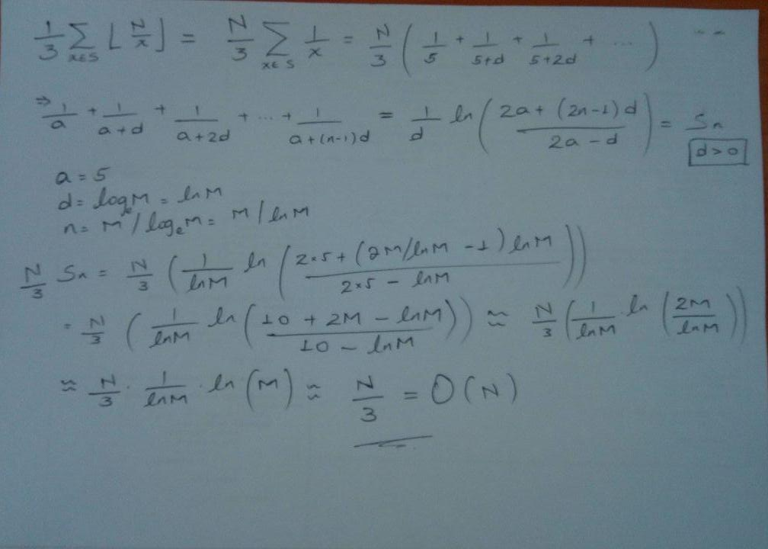
Complexity Analysis
Andalus Prime

Slide 28
Topics
    Introduction
    Sieve of Eratosthenes
    Andalus Prime Algorithm
    Complexity Analysis
    Mersenne Prime
Andalus Prime

Slide 29
Mersenne Prime
Enter French monk Marin Mersenne (1588-1648). Mersenne stated in the preface to his Cogitata Physica-Mathematica (1644) that the numbers 2^{n}-1 were prime for
  n = 2, 3, 5, 7, 13, 17, 19, 31, 67, 127 and 257
and were composite for all other positive integers n < 257.
Definition: When 2^{n}-1 is prime it is said to be a Mersenne prime.
New record prime (GIMPS): 2^{82,589,933}-1 with 24,862,048 digits(it is sol large that it would easily fill 9,000 book pages) by P. Laroche, G. Woltman,
A. Blosser, et al. (7 Dec 2018).
It is 51st Mersenne Prime.
Andalus Prime

Slide 30
Mersenne Prime
The 50th Mersenne prime, simply written 2⁷⁷²³²⁹¹⁷ – 1(two to the power of 77, 232, 917 minus one) was found by a volunteer who had dedicated 14 years of computing time to the endeavor.
Andalus Prime

Slide 31
Application of prime numbers
RSA
n=p×q
ϕ(n)=(p−1)x(q−1)
gcd(e, ϕ(n)) = 1
de = 1(mod ϕ(n))
Me mod n
C^{d} mod n
Andalus Prime

Slide 32
              Thank you
Andalus Prime

Slide 33
Each prime number starting from p*p to erase the pseudo prime numbers.
Each pseudo prime number marked only once by the smallest prime factor.

